Slide 1



Extreme Weather Conditions and Real-Time Alerting
Dimitris Kasseropoulos
Katerina Psallida
Prepared for the Big Blue Data Academy, Data Engineering Bootcamp, February 2025
Notes:
Κατερίνα

Slide 2

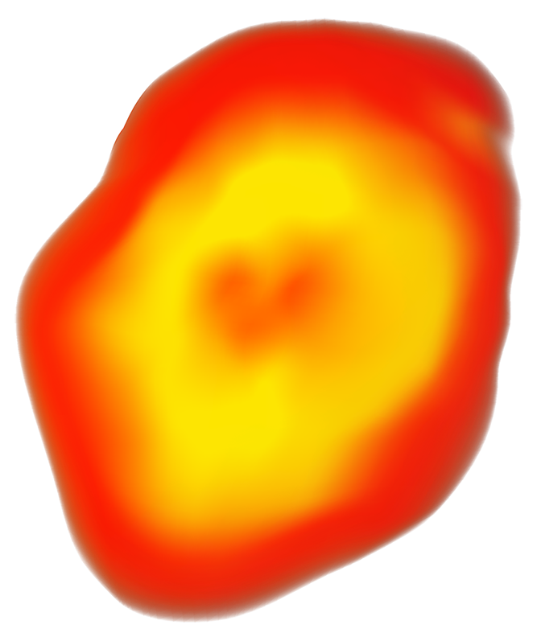



Who we are
Katerina Psallida
Dimitris Kasseropoulos
Work Experience
Digital Sales for Data & AI Products
Marketing Professional
SAP Netweaver / Basis Technical Consultant
Work Experience
O Data Engineer & Operations
O Operations Analyst
Studies
O MSc Data Science
O BSc Physics
Studies
Data Science Bootcamp
Professional Diploma in Data Analytics
MSc Computational Physics
BSc Physics
Notes:
Logo για τους οργανισμούς
Big Blue Data Academy
Κατερίνα
Δημήτρης

Slide 3
The Agenda
01
02
03
04
05
The Project Mission
The Technologies implemented
The Methodology
The Results
The Conclusion & Future Work
Notes:
Δημήτρης - Συμπεράσματα και περισσότερες ιδέες μελλοντική εξελίξη

Slide 4
01
The Project Mission
Notes:
Πάσα Δημήτρη για Κατερίνα

Slide 5
The Project Mission : Agriculture & Farming
Helping farmers make data-driven decisions—when to irrigate, when to harvest, and when to take preventive measures.
Providing real-time alerts for weather conditions (frost, heatwaves, heavy rainfall).
Analyzing historical weather patterns to predict risks and plan crop cycles efficiently.
Notes:
Κατερίνα

Slide 6
02
The Technologies implemented
Notes:
Κατερίνα

Slide 7
The technologies implemented: In a nutshell
DESIGN and Implement the Database Model
EXTRACT data from APIs . Ensure efficient data retrieval using optimized calls.
INITIAL FULL LOAD of Staging, Dimension, Fact Tables
Implement Incremental Data Loading
Identify Weather Patterns and activate Alerting Mechanisms
Orchestrate the Workflow
Notes:
Κατερίνα

Slide 8


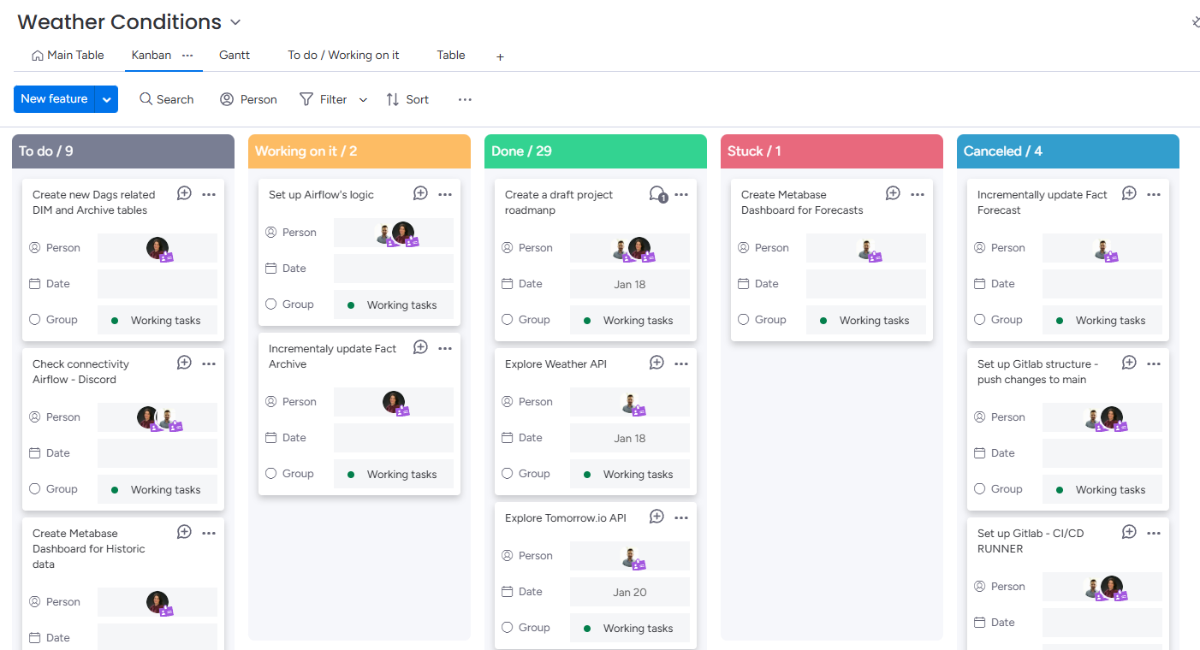
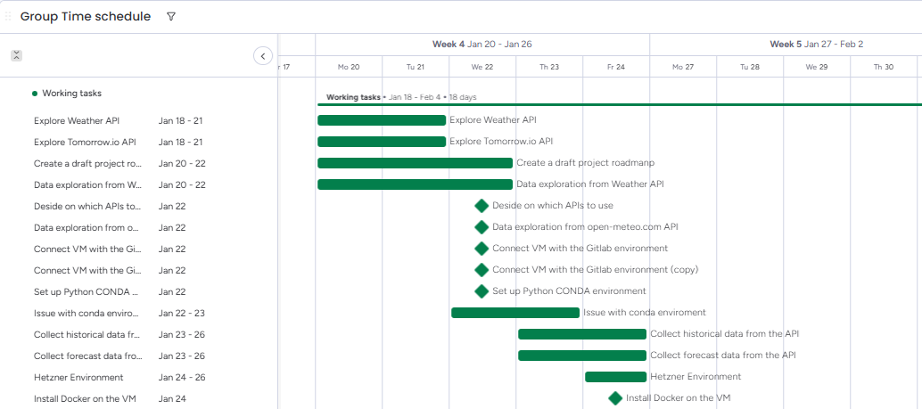
The technologies behind the project: Collaboration
Kanban Board
Code Versioning
Gantt Chart
Notes:
Δημήτρης : Λιγότερα εδώ

Slide 9












The Technologies behind the project
Notes:
Προγραμματιστικά
Αρχιτεκτονική -> VM - Docker - Postgres/Airflow/Metabase
Τελικός προορισμός
Δημήτρης

Slide 10



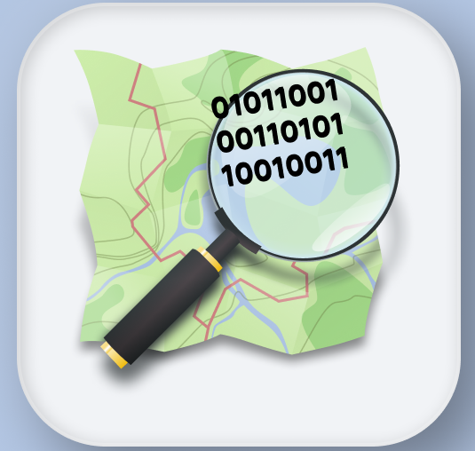
The Technologies implemented : APIs
Open-Meteo
Data since 1940 16 day ahead forecast
National Centers for Environmental Information
Information about the Weather Code
Nominatim
Find city coordinates with an easy to use API
01 -01 -2020 31 - 01 - 2025
25 Cities in Greece
28 weather codes
1.2 million Rows of Hourly Historical Data
10 K Forecast Records
Notes:
Κατερίνα

Slide 11
03
The methodology

Slide 12
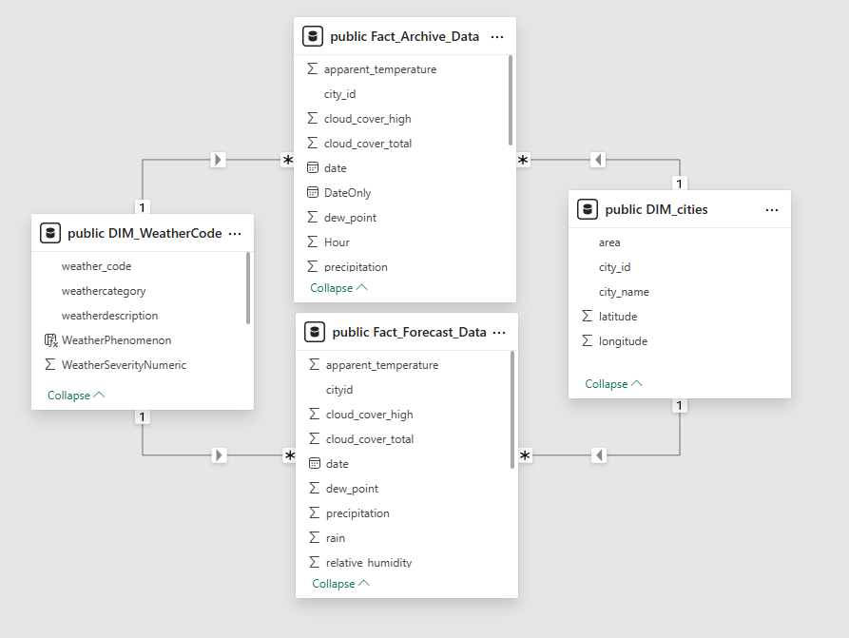

The Methodology: The data model
Staging

Slide 13

The methodology: The Data Flow for Historical Analysis
ETL Full Load Process
DIM Tables
Processing &
Data Enrichment
Dashboards
FACT
STAGING
ETL Incremental Upload Process
Contact API
For incremental data
Extract latest timestamp from Fact Table

Slide 14
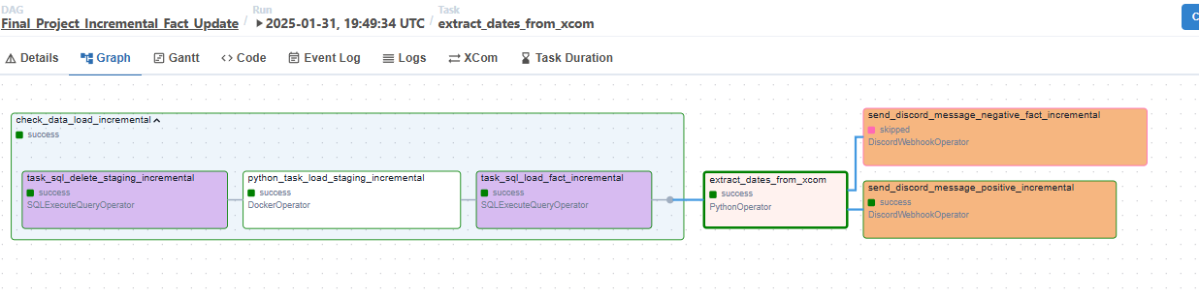
The methodology: AIRFLOW orchestration - Historical

Slide 15
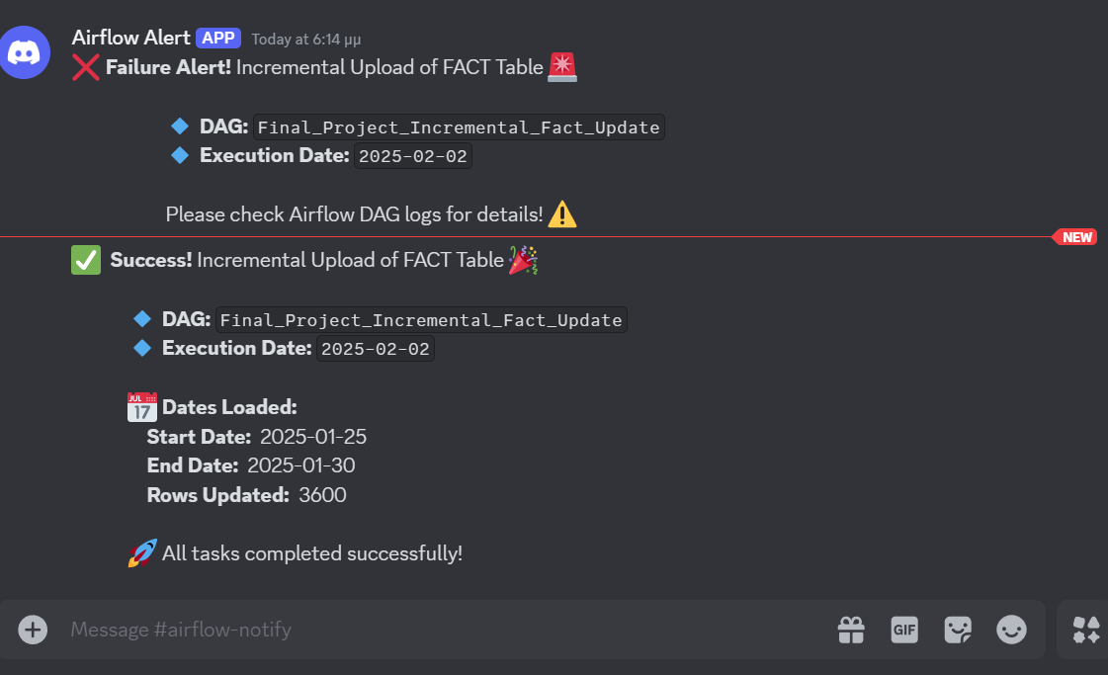
The methodology: AIRFLOW Load Alerts
Notes:
Κατερίνα

Slide 16
The methodology: Data Flow for Forecasting & Alerting
ETL Process
Metabase
Diagrams
Dimension Tables
Processing &
Data Enrichment
Fact Table
Staging Table
Alerting
Notes:
Δημήτρης - Σε αυτό το στάδιο, μιλάμε για 3 φασεις. 1 παίρνουμε τα δεδομένα απ το API - στο 2ο τα συνδιάζουμεμε έξτρα πληροφορία

Slide 17
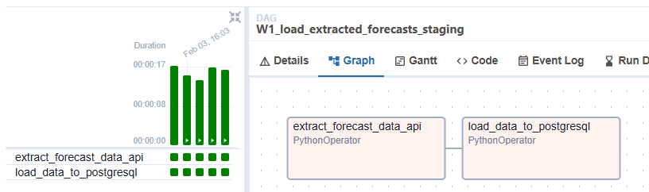
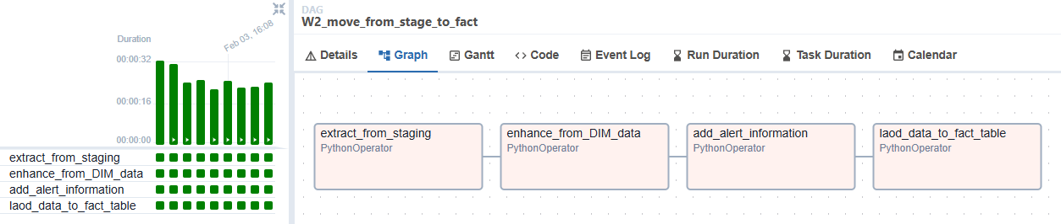
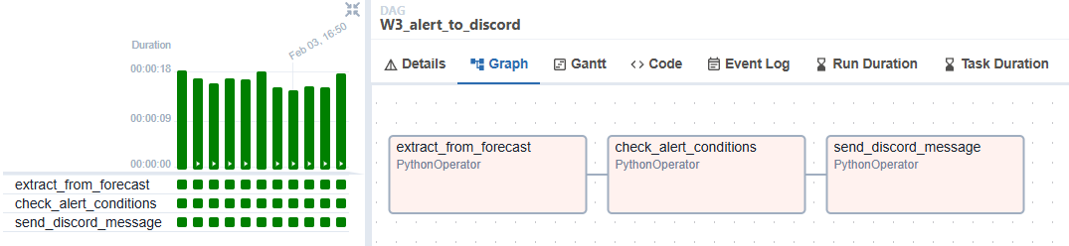
The methodology: AIRFLOW orchestration - Forecast
Notes:
Εδώ βλέπουμε πως υλοποιήθηκαν μέσω Airflow τα βήματα που περιγράψαμε στην προηγούμενη διαφάνει χρησιμοποιώντας και Python Operators

Slide 18
04
The Results
Notes:
Κατερίνα

Slide 19
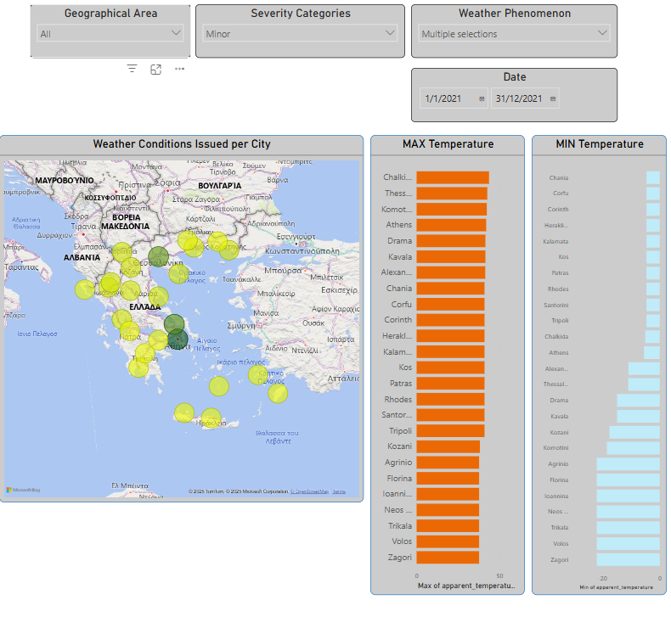
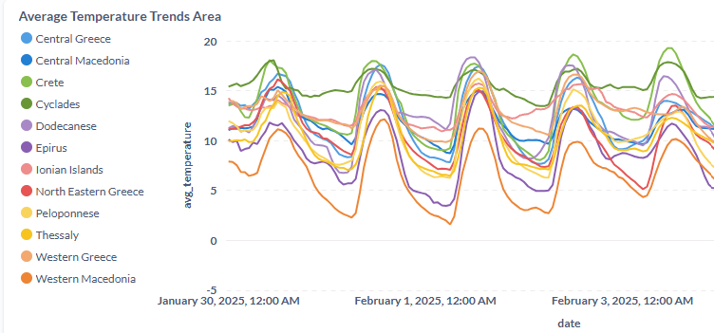
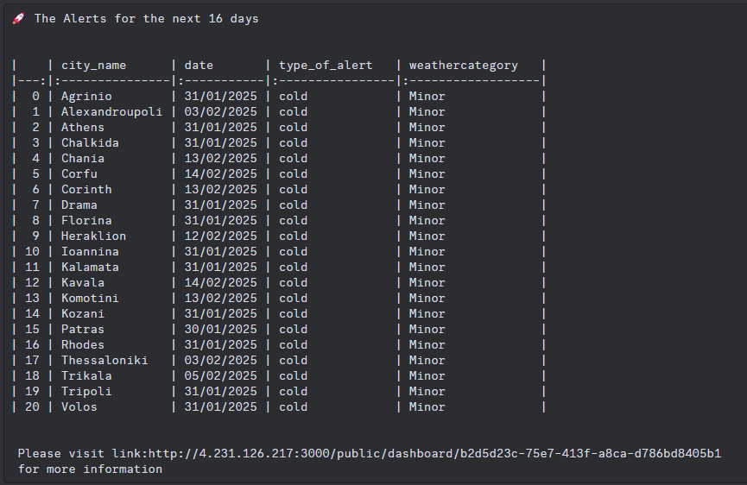
The Results
Power BI Dashboards
Metabase Diagrams
Discord Alert messages
Metabase Link
Notes:
Κατερίνα - > Δημήτρης

Slide 20
05
The Conclusions and Future Work

Slide 21
The Conclusions & Future Work
Utilize data from more sources
Implement Email alerting
Include more cities and rural areas in the model
Design the architecture to be more scalable and automated
CI/CD
DAG triggering
Incorporate more error handling scalability and fault tolerance
Notes:
Δημήτρης : 3 πρώτα
Κατερίνα : 3 Τελευταία

Slide 22


Θενξ !
Katerina Psallida
Dimitris Kasseropoulos
katherinepsallida@gmail.com
dkassero@gmail.com
Notes:
Κατερίνα

Slide 23
References
Open-Meteo. Free Open-Source Weather API. Open-Meteo.com, https://open-meteo.com. Accessed 20 Jan. 2025.
Nominatim. City Coordinates: Search Service. OpenStreetMap, https://nominatim.openstreetmap.org/search. Accessed 20 Jan. 2025.
National Centers for Environmental Information. Weather Codes: WMO Code Table 4677. https://www.ncei.noaa.gov. Accessed 20 Jan. 2025.
Clésio, Flávio. "Using Apache Airflow DockerOperator with Docker Compose." Towards Data Science, Medium, https://medium.com/towards-data-science/using-apache-airflow-dockeroperator-with-docker-compose-57d0217c8219. Accessed 20 Jan. 2025.
Lamberti, Marc. "Airflow DAG: Coding your first DAG for Beginners." YouTube, uploaded by Data with Marc, 3 Apr. 2019, https://www.youtube.com/watch?v=IH1-0hwFZRQ. Accessed 2 Feb. 2025.
Wilson, Bibin. "How to Run Docker in Docker." DevOpsCube, 12 Sept. 2023, https://devopscube.com/run-docker-in-docker/. Accessed 2 Feb. 2025.

Slide 24
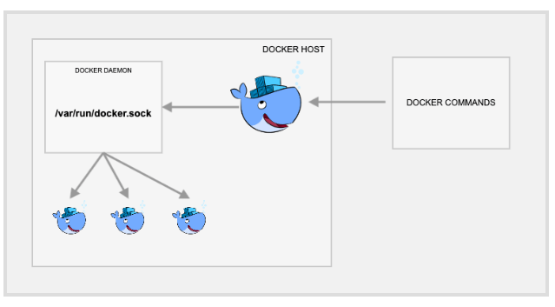

The methodology: Appendix
Docker in Docker using docker.sock
airflow
temporary
metabase

